Slide 1
Chapter 39
Promoting Musculoskeletal Function

Slide 2
Lesson 39.1 Overview of Immobilization Problems
Theory
Discuss the effects of inactivity on respiratory exchange and airway clearance.
Describe appropriate care of a cast as it dries.
Verbalize the differences among an air-fluidized bed, low air-loss bed, and continuous lateral rotation bed, listing the reasons for their use.
Name at least four pressure relief devices that help prevent skin injury in immobile patients.

Slide 3
Lesson 39.1 Overview of Immobilization Problems
Clinical Practice
Devise a plan of care for meeting the psychosocial needs of the alert, immobile patient.
Correctly care for the patient undergoing skin traction.
Use lift sheets and roller or slide devices to move immobilized patients.

Slide 4
Immobilization
Bed rest may be required when patients are recovering from a variety of conditions
Stroke, trauma
Neuromuscular disorder
Chronic debilitating illness
Complications caused by immobilization
Pressure injuries, pneumonia
Bone loss
Loss of function in the immobilized part
Notes:
Even though bed rest may be required, the complications can be severe.
Which allied health professionals can be called on to help prevent complications? Hospital nurses, home health care nurses, nursing assistants, physical therapists, occupational therapists

Slide 5
Systemic Effect of Immobilization (Slide 1 of 7)
Cardiovascular system
Effect
Venous stasis, increased cardiac workload, blood pressure alterations
Problems/complications
Thrombus formation
Thrombophlebitis
Pulmonary embolus
Orthostatic hypotension
Increased pulse rate
Notes:
What nursing interventions are implemented to prevent cardiovascular complications?
Perform cardiovascular assessment and vital signs at each shift, and administer anticoagulants and encourage ambulation as ordered.
Encourage patient to perform active or passive range-of-motion exercises, and isometric exercise if not contraindicated.
Assist in use of sequential compression devices (SCDs) or foot pumps, which promote venous return.
Have patient dangle before standing or walking.

Slide 6
Systemic Effect of Immobilization (Slide 2 of 7)
Respiratory system
Effect
Stasis of secretions, decreased elastic recoil, decreased vital capacity
Problems/complications
Hypostatic pneumonia
Bacterial pneumonia
Atelectasis
Decreased gas exchange
Notes:
What nursing interventions are implemented to prevent respiratory complications? Perform respiratory assessment and vital signs check at each shift; instruct patient to turn, cough, deep-breathe every 1-2 hours; instruct in use of incentive spirometer 10 times every 1 hour; encourage ambulation if ordered; monitor laboratory results for abnormalities that could signal infection; administer or request respiratory treatment if ordered; report new abnormal changes to physician.

Slide 7
Systemic Effect of Immobilization (Slide 3 of 7)
Gastrointestinal (GI) tract
Effect
Anorexia, metabolic change to catabolism and negative nitrogen balance, decreased peristalsis
Problems/complications
Weight loss
Protein deficiency
Abdominal distention
Constipation
Notes:
What nursing interventions can be implemented to prevent gastrointestinal complications?
GI assessment at each shift.
Check daily weights and administer stool softeners/laxatives if ordered.
Monitor laboratory test results for abnormalities.
Assess patient’s food intake for proper nutrients, encourage extra fluids and fiber if not contraindicated.
Ask patient if passing gas or stool.
Report new abnormal changes to physician.

Slide 8
Systemic Effect of Immobilization (Slide 4 of 7)
Musculoskeletal system
Effect
Decreased muscle mass and muscle tension, shortening of muscle, loss of calcium from the bone matrix, decrease in bone weight
Problems/complications
Fibrosis of connective tissue
Atrophy
Weakness
Joint contracture
Osteoporosis, bone pain
Notes:
What nursing interventions are implemented to prevent musculoskeletal complications?
Perform musculoskeletal assessment at each shift.
Active and passive ROM exercises.
Administer calcium supplements as ordered.

Slide 9
Systemic Effect of Immobilization (Slide 5 of 7)
Urinary system
Effect
Stasis of urine, urinary tract infection, renal stones
Problems/complications
Precipitation of calcium salts
Frequency of urination
Dysuria
Notes:
What nursing interventions are implemented to prevent urinary complications?
Keep accurate record for intake and output.
Monitor for reports of pain with urination or changes in urination, such as frequency.
Encourage increase of fluid intake.
Encourage change of position (for kidneys).
Monitor vital signs every shift.
Report new abnormal findings to physician.

Slide 10
Systemic Effect of Immobilization (Slide 6 of 7)
Skin
Effect
Decreased circulation from pressure, ischemia, and necrosis of tissue
Problems/complications
Skin breakdown
Pressure ulcers
Notes:
What nursing interventions are implemented to prevent skin complications?
Perform skin assessment at each shift, and keep linens dry, smooth, and clean.
Turn patient every 2 hours.
Use pressure devices/cushions if needed.
Encourage fluid intake for skin turgor hydration.
Use mild bathing products and skin lotion.
Encourage out of bed (OOB) as indicated.
Report new abnormal findings to physician.

Slide 11
Systemic Effect of Immobilization (Slide 7 of 7)
Brain/psychological
Effect
Decreased mental activity, decreased sensory input, decreased socialization, decreased independence
Problems/complications
Disorientation, confusion
Boredom, anxiety
Depression, loneliness
Notes:
What nursing interventions can be implemented to prevent psychological complications?
Orientation assessment every shift.
Encourage visitation from family/friends.
Place patient in chair at nurses’ station if possible (for more interaction).
Provide patient with reading materials or other appropriate activities of interest.
Administer antidepressants as ordered.
Report new abnormal findings to physician.

Slide 12
Preventing Physical Complications of Immobilization
Encourage increasing fluid intake to 3 L/day
Encourage adequate nutritional intake
Encourage increased fiber in diet
Administer stool softeners and laxatives (as ordered)
Encourage passive/active ROM exercises
Encourage isometric exercises
Turn every 2 hours
Keep skin clean and dry, use pressure-relief devices
Notes:
What other types of patients would benefit from these actions? All postoperative, elderly, confused, and homeless patients

Slide 13
Psychosocial Effects of Immobilization
Effects
Fear, abandonment, loss, etc.
For children, diversionary activities such as games, movies, story reading
For adults
Television, reading, crafts
Crossword puzzles
Frequent visitors
Nonalert and comatose patients may also need support
Notes:
Children may tend to regress back to an earlier stage. Try to keep the child busy with appropriate activities and focused on something other than him- or herself.
For adults, the same can be true. Provide activities that are stimulating to the mind.
Why is it important to treat the nonalert and comatose patient like the other patients? There have been reports from patients who have come out of a coma who remember being talked to by others and remember voices. Always speak to the person as if he or she were awake.

Slide 14
Types of Immobilization
Splints
Traction
Skin
Skeletal
Casts
External fixators

Slide 15
Splints
Protect injured parts by immobilizing them
May be used as first aid before cast application
Types available
Molded splints, immobilizers, inflatable splints, cervical collars, traction splints
Inflatable splints may be used to control bleeding; they should be inflated until they can be indented 1½ inches by fingertips
Immobilizers are made of cloth, foam, and Velcro
Notes:
Which allied health professionals might apply splints more than others? Paramedic or EMS, because they stabilize limb problems at the scene of an accident
What would be some priority actions if someone experiences a fracture in your presence? Do not change the position of the injured part, because further nerve damage could occur. Cover any open wounds with sterile or clean material. Use rigid splint material [flat board to immobile injured part]. Pad bony prominences to prevent pressure ulcers. Secure with wide bands of material to aid in immobilization. Elevate to decrease edema. Transport to medical facility.

Slide 16
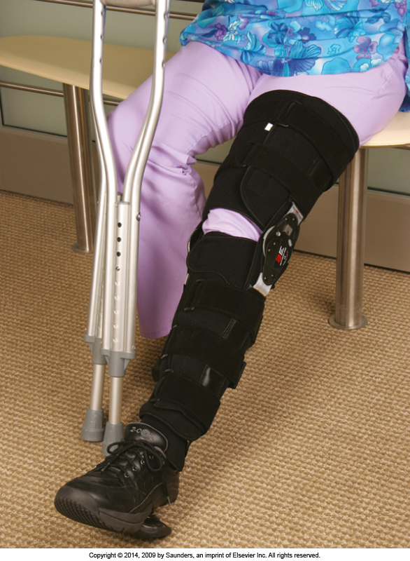
Figure 39.1: Patient with a leg brace or splint
Notes:
Discuss why a patient may need a brace or splint.
Textbook figure 39.1

Slide 17
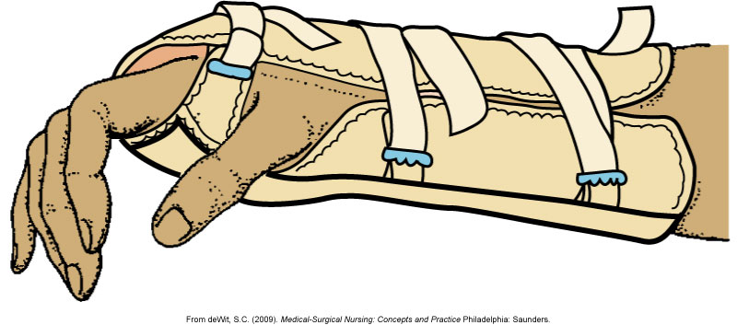
Figure 39.2: Wrist and forearm splint
Notes:
Have students discuss why they think a patient would need a splint on the wrist or forearm.
Textbook figure 39.2

Slide 18
Traction (Slide 1 of 3)
A pulling force used to maintain body alignment, maintain fracture alignment, and relieve pain and muscle spasm
Can be skin traction or skeletal traction
Patients in traction should have an overhead frame and trapeze bar
Weights should swing freely without touching bed or floor
Notes:
What would be the difference of care in a patient with traction who is 25 years of age versus one who is 75 years of age? The younger person probably has more strength to help adjust self in bed and promote more turning. A younger person also may be more coherent to participate in self-care and breathing exercises. An elderly person may exhibit some confusion and not be as compliant in self-care and breathing, or may lack the strength to change positions. More reminders and actual assistance may have to be given. Also, skin care and assessment would be a priority.
What important assessment would both patients require? neurovascular checks every 4 hours

Slide 19
Traction (Slide 2 of 3)
Skin traction
Uses Velcro boots, belts, halters, and slings
Applied snugly to the skin
Main purpose is to decrease spasm accompanying fractures
Weight is generally limited to 5 to 10 lb
Complaints of skin pain must be reported
Notes:
Skin traction is usually applied before surgery to help relieve the pain from spasms.
Why is it important for the weight to swing freely at the end of the bed? Because no pulling action will be achieved if it is touching the floor
Would a patient in skin traction still require pain medication? Although the traction helps alleviate the pain, any movement of the affected extremity does cause pain, and the patient may request it to help him or her relax until surgery is scheduled.

Slide 20
Traction (Slide 3 of 3)
Skeletal traction
Requires surgical placement of pins, tongs, screws, or wires anchored to the bone
Can support more weight than skin traction
Nurse is responsible for maintaining correct weight, alignment, and balance
Clear fluid drainage around pins is expected
Any sign of infection must be reported immediately
Circulation checks are performed every hour for the first 24 hours, then every 4 hours thereafter
Notes:
How could you alleviate a patient’s fears about being placed in skeletal traction? Educate patient that the pins cannot pop out as a result of his movements. He can put his HOB up and turn on his side as long as the weights hang freely.
If a patient is concerned about bowel movements, what could you tell him? He can use the trapeze bar to pull himself up for bedpan or suppository placement. Encourage extra fluids or laxatives to promote bowel elimination.

Slide 21
Cast (Slide 1 of 2)
Used to immobilize an extremity following a fracture or orthopedic procedure
Skin is protected by a layer of stockinette, followed by a layer of padding
Cast is then applied (can be plaster or fiberglass)
Cast must be protected during drying to prevent dents and uneven pressure, which can cause circulatory impairment and pressure injuries
Notes:
A cast can be very heavy to a patient. What could staff do to assist with ambulation? Support patient on either side, and give encouragement.
What activities could you perform for a patient who has a cast on each lower extremity? Because the patient will not be walking at first, perform passive ROM activities by lifting legs toward chest.

Slide 22
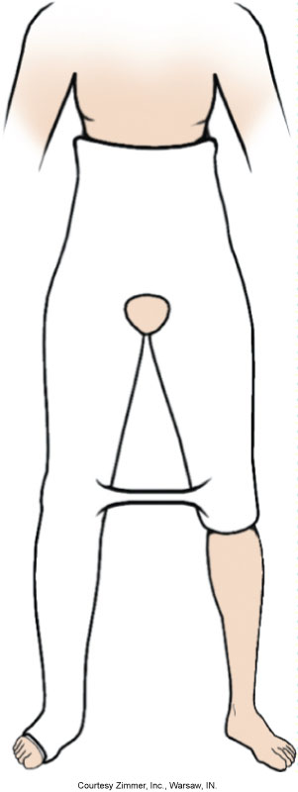
Figure 39.4: Hip spica cast
Notes:
Textbook figure 39.4

Slide 23
Cast (Slide 2 of 2)
When handling a cast, use the palms of the hands and the flat part of the fingers
Swelling is common and, if left uncontrolled, can cause circulatory impairment and pressure injury
Cast edges should be padded
Tight cast may be bivalved
Bars on hip spica cast should not be used for lifting or turning
Notes:
What would be a sign or symptom that a patient is experiencing swelling with a cast? How would you respond? Pain is the most common complaint if swelling has occurred. Always perform a neurovascular assessment with complaints of pain. Report abnormal swelling to the physician. Try repositioning affected body part, and provide elevation.

Slide 24
External Fixators
Pins, screws, or tongs inserted through one or more bones to stabilize fragments during healing
Metal inserts are attached to an external frame
Fixators allow patient to be more active
Device needs to be checked for stability every 4 hours
Pin care is required to prevent infection
Notes:
What are the advantages of an external fixator versus a cast on an extremity? The ex-fix is lighter and not as bulky as a cast. The extremity is visible for skin inspection. The skin is not wrapped, and air is able to circulate around skin. Bony prominences are not compromised by the cast pressure.

Slide 25
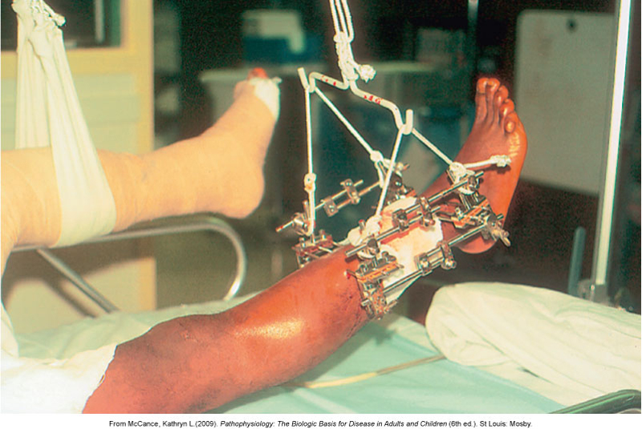
Figure 39.5: An external fixator holding fractured bones in place
Notes:
Discuss how this device is different from skeletal or skin traction.
Textbook figure 39.5

Slide 26
Devices Used to Prevent Problems of Immobility
Air-fluidized beds
Tiny silicone beads contained within the bed under a flexible, air-permeable filter sheet
Low air-loss beds
Achieved by distributing air through multiple cushions connected in a series
Continuous lateral-rotation beds
Bed turns in an arc up to 80 degrees and can be set to pause on either side for up to 30 minutes
Notes:
What is one way to determine if a patient would benefit from a specialty bed? Most facilities have a Braden or Norton Scale that is charted every 24 hours. The areas assessed may include patient’s overall condition, mental state, activity, mobility, nutrition, and incontinence. If the total number is below his recommended number, the physician is notified and a specialty bed may be ordered.
How many hours of CPM use are recommended per day? Usually a minimum of 6 hours, spread out in 2-hour increments
What department is most involved in teaching exercise to the patient? Physical therapy

Slide 27
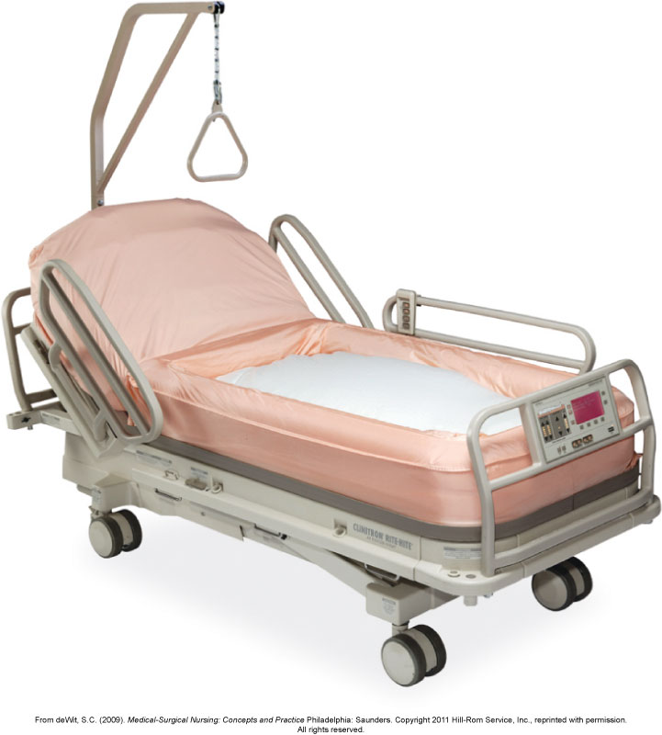
Figure 39.6: Clinitron-Elexis air-fluidized therapy unit
Notes:
What complication of immobility would this device help to prevent? Air fluidized therapy is effective in the prevention of pressure injury and helps reduce generalized body pain common among bedridden patients.
Textbook figure 39.6

Slide 28
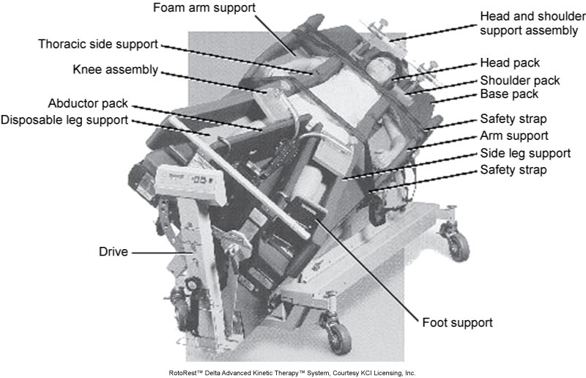
Figure 39.7: Roto-Rest Delta kinetic therapy bed
Notes:
Discuss the difference between this bed and the air-fluidized therapy unit.
Textbook figure 39.7

Slide 29
Devices Used to Prevent Problems of Immobility (Slide 2 of 3)
Pressure-relief devices
Aid in reducing skin trauma from pressure for patients in standard hospital beds
Foam and gel pads
Sheepskin pads
Heel and elbow protectors
Pulsating air pads
Water mattresses that lie on top of the regular mattress
Notes:
Have students discuss how a patient might get these devices.

Slide 30
Figure 39.8: Alternating air mattress pad
Notes:
Textbook figure 39.8

Slide 31
Figure 39.9: Heel protector helps prevent skin breakdown
Notes:
Discuss the complications of using the heel protector.
Textbook figure 39.9

Slide 32
Devices Used to Prevent Problems of Immobility (Slide 3 of 3)
Continuous passive motion machine
Often ordered to restore joint function after orthopedic surgery to replace a joint
Used to exercise the extremity and joint, thus preventing contracture, muscle atrophy, venous stasis, and thrombus formation
Notes:
How many hours of CPM use are recommended per day? Usually a minimum of 6 hours, spread out in 2-hour increments
The equipment extends the extremity to a prescribed angle for a specific period of time and then releases the joint, flexing it again.
As the degree of joint motion is tolerated, the settings are altered to increase the mobility of the joint.

Slide 33
Figure 39.10: Continuous passive motion machine for the knee joint
Notes:
Discuss what occurs to the circulatory system when this equipment is being used.
Textbook figure 39.10

Slide 34
Therapeutic Exercise
Physical therapy often ordered for patient who is immobilized for an extended period of time
Full ROM exercises should be performed either actively or passively several times a day
To prevent joint injury while performing passive ROM exercises, support the limb to be exercised above and below the joint
Notes:
The physician indicates what the problems are for the patient, and the therapist performs an evaluation and then designs an exercise program to help the patient and to prevent further musculoskeletal problems.
Who may assist the patient perform exercises if the physical therapist is not available? The nurse

Slide 35
Question 1
Sharon’s patient has had restricted movement for a long time. One major complication Sharon’s patient might develop is:
hypostatic pneumonia.
aspiration pneumonia.
paresthesia.
generalized weakness.
Notes:
Answer: 1
Rationale: One major concern when a patient’s movement is restricted is the development of respiratory complications. Hypostatic pneumonia is a pneumonia caused by stasis of secretions as a result of inactivity. Swallowing fluid in the lungs causes aspiration pneumonia. Paresthesia is a feeling of numbness or tingling. Generalized weakness is an expected outcome, not a major complication from prolonged immobilization.

Slide 36
Question 2
Sharon’s patient has a continuous passive motion machine. This machine is used to:
turn the patient every 2 hours.
have her cough and deep-breathe.
provide immobilization to a fractured area.
exercise the joint after a joint replacement surgery.
Notes:
Answer: 4
Rationale: A continuous passive motion machine is used to exercise a joint after joint replacement surgery. After any surgery, a patient should be able to turn or be turned every 2 hours, cough, and deep-breathe. A cast is used to provide immobilization to a fractured area.

Slide 37
Question 3
Sharon is working on an orthopedic floor. How often should she inspect casts for cracks, crumbling, pressure problems, and infections?
Every 2 hours
Every 4 hours
Every 6 hours
Every shift
Notes:
Answer: 4
During your assessment, which is every shift, you should inspect casts for cracks, crumbling, pressure problems, and signs of infection. If you discover any of these conditions, they should be reported to the charge nurse and/or physician.

Slide 38
Lesson 39.2 Assisting the Immobilized Patient (Slide 1 of 2)
Theory
Describe how to perform a neurovascular assessment on an immobilized extremity.
Discuss the use of bandages and slings to immobilize a body part.

Slide 39
Lesson 39.2 Assisting the Immobilized Patient (Slide 2 of 2)
Clinical Practice
Teach a patient to properly care for a cast following discharge.
Correctly apply an elastic bandage to a stump after an amputation.
Transfer a patient using a mechanical lift.
Assist a patient with the use of each of the following: walker, crutches, cane, brace, prosthesis, and wheelchair.

Slide 40
Assessing the Immobilized Patient
Assess for indicators of circulatory impairment
Look for signs of respiratory impairment
Determine which activities of daily living the immobilized patient can perform
Perform a neurovascular assessment for any patient with a cast or traction device
Assess for cultural beliefs and customs
Assess traction pulleys and ropes for proper function and free movement
Assess any aids to ambulation for structural problems, fit, and safety
Assess patient’s gait to determine stability
Notes:
What areas of an assessment are important to include in your nursing documentation? Besides the regular assessment [head-to-toe systems], you should include a more detailed assessment on the immobilized body part.
What particular assessments are the focus of an immobilized body part? skin, movement, sensation, pulses, capillary refill, pain

Slide 41
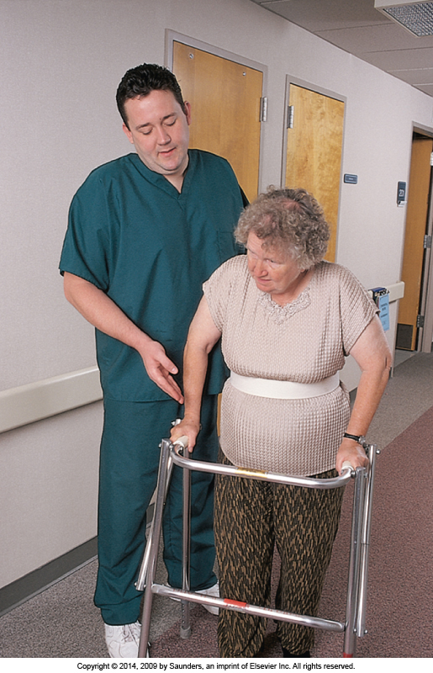
39.11: Assess the gait of the patient learning to use a walker
Notes:
Discuss how to determine if the patient is able to use a walker correctly.
Textbook figure 39.11

Slide 42
Nursing Diagnosis/ Problem Identification
Altered mobility r/t hemiparesis or hemiplegia (one-sided weakness/one-sided paralysis)
Altered physical mobility r/t fractured extremity in traction or a cast
Altered peripheral tissue perfusion (circulation of blood through tissue) r/t decreased circulation in the lower extremities
Altered skin integrity r/t skin disruption
Acute pain r/t tissue or bone injury, or muscle spasm
Alteration in airway clearance r/t inactivity and bed rest
Potential for disuse syndrome
Potential for impaired neurological function r/t fracture and cast application
Notes:
What body systems are addressed with these nursing diagnoses? Musculoskeletal, nervous, cardiovascular, integumentary, respiratory
What additional nursing diagnoses would be appropriate for the immobilized patient? Anxiety, Disturbed body image, Confusion, Fear, Incontinence, Risk for infection, Powerlessness, Self-care deficit, Disturbed sleep pattern

Slide 43
Bandages Used to Support, Apply Pressure, or Immobilize
Applying elasticized bandages
Elevate and support limb while applying
Wrap from distal to proximal; apply even pressure while wrapping
Overlap turns equally; smooth out wrinkles
Secure the end with safety pin, tape, or clips supplied with bandage
Check neurovascular status
Remove and rewrap at least twice a day
Notes:
A bandage change may cause discomfort for a patient. What are some interventions the nurse could implement to provide comfort? Administer pain medication 30 minutes before change, ask for another staffer to assist with supporting limb if needed, explain to patient what you are doing, and provide distraction during procedure.

Slide 44
Bandage Wrapping Techniques (Slide 1 of 2)
Circular turn
Used to anchor the bandage and to terminate the wrap
Spiral turn
Used to bandage parts of the body that are uniform in circumference
Spiral reverse turn
Used to bandage body parts not uniform in circumference
Figure-of-eight turn
Used to bandage and stabilize an elbow, knee, or ankle, or to immobilize and hold a fractured clavicle in position
Notes:
What types of injuries require use of each type of bandage?
circular—proximal aspect of finger or wrist
spiral—upper arm, upper leg
spiral reverse turn—lower leg or forearm
figure-of-eight turn—elbow, knee, ankle; or to immobilize and hold fractured clavicle

Slide 45
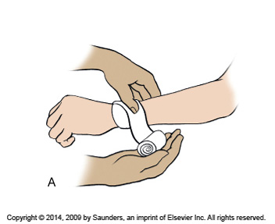
Figure 39.12A: Applying an elastic bandage—circular turns
Notes:
Discuss why a circular type of elastic bandage is used.
Textbook figure 39.12A

Slide 46
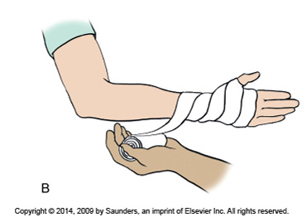
Figure 39.12B: Applying an elastic bandage—spiral turns
Notes:
Discuss why a spiral type of elastic bandage is used.
Textbook figure 39.12B

Slide 47
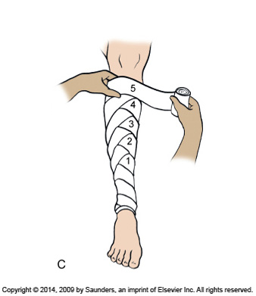
Figure 39.12C: Applying an elastic bandage—spiral reverse turns
Notes:
Discuss why a spiral reverse type of elastic bandage is used.
Textbook figure 39.12C

Slide 48
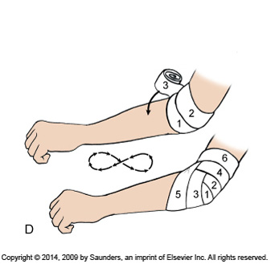
Figure 39.12D: Applying an elastic bandage—figure-of-eight turns
Notes:
Discuss why a figure-of-8 turn of elastic bandage is used.
Textbook figure 39.12D

Slide 49
Bandage Wrapping Techniques (Slide 2 of 2)
Recurrent turn
Used to cover distal parts of the body
Thumb spica
A variation of the figure-of-8 bandage used to support the thumb in neutral position following a sprain or other injury
Sling
Holds extremity in an elevated position to avoid edema of the hand, pain and discomfort, and fatigue
Notes:
What types of injuries require use of each type of bandage?
recurrent turn—end of finger, skull, stump left by amputation
thumb spica—thumb, hip, shoulder
sling—wrist, elbow, shoulder

Slide 50
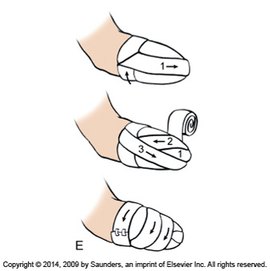
Figure 39.12E: Applying an elastic bandage—recurrent turn bandaging
Notes:
Discuss why a recurrent type of elastic bandage is used.
Textbook figure 39.12E

Slide 51
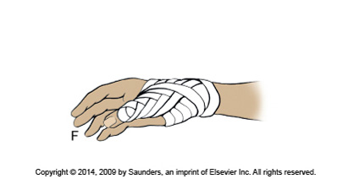
Figure 39.12F: Applying an elastic bandage—thumb spica bandaging
Notes:
Discuss why a thumb spica bandaging type of elastic bandage is used.
Textbook figure 39.12F

Slide 52
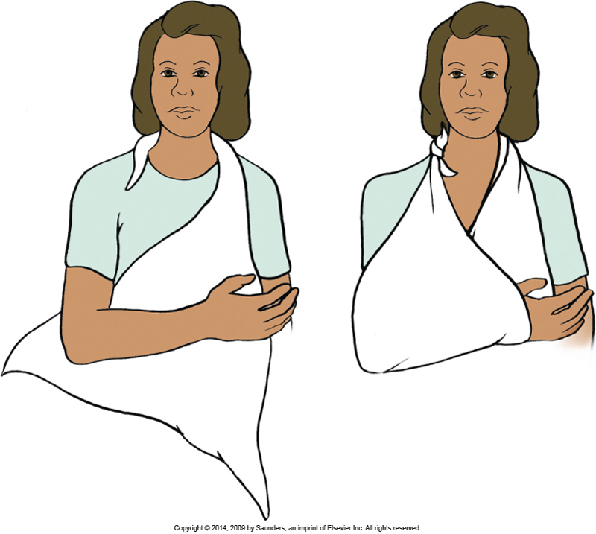
Figure 39.13: A triangular bandage sling
Notes:
Discuss why a triangular bandage sling is used.
Textbook figure 39.13

Slide 53
Using a Mechanical Lift to Transfer Immobile Patients
Can be used to move a patient from bed to chair or stretcher and back again
Hydraulic pump allows one nurse to lift patient
It takes two people to use the lift safely
Patient must never be left unattended in the lift
Also used to place patients into a tub or whirlpool bath for bathing or hydrotherapy
Notes:
What types of patients would a mechanical lift be helpful in transferring? New amputee, obese person who cannot stand, very weak person, person with casts on each leg, paraplegic or quadriplegic patients

Slide 54
Aids to Mobilization (Slide 1 of 2)
Walkers
Frequently the first mechanical aid used when training an individual to walk following a loss of function
Crutches
May follow the use of a walker or be the first aid to ambulation
Canes
Most commonly used canes are the standard (one-point) and the quad (four-point) cane
Notes:
What are priority teaching points regarding the assistive devices?
The nurse must wear proper footwear to prevent slipping.
Keep floors clear of clutter.
Keep pathways well-lit.
Keep device within reach of patient.
The devices should be adjusted to fit patient’s height.
Report problems to physician or caregiver.

Slide 55
Aids to Mobilization (Slide 2 of 2)
Wheelchairs
Used for patients who are not able to ambulate either independently or with aids
Braces, splints, and prostheses for stabilization
Prostheses are used to replace missing body parts
Notes:
Braces and splints are used to strengthen and support areas of the body affected by weakness or paralysis

Slide 56
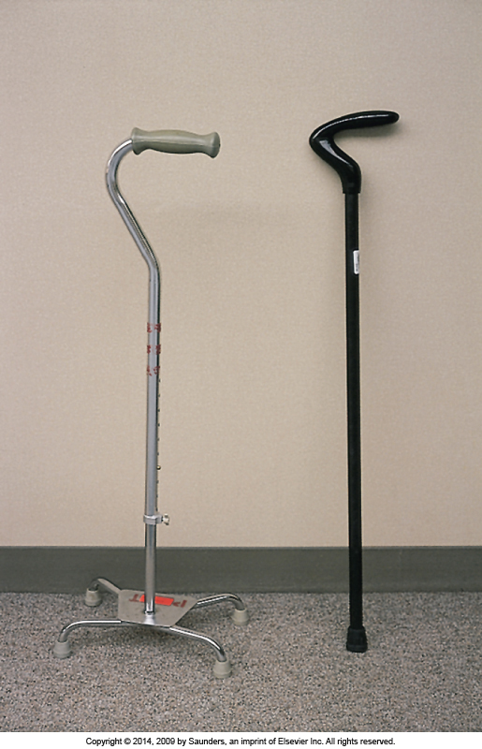
Figure 39.16: Regular cane (right) and quad cane (left)
Notes:
A regular cane provides support, whereas a quad cane provides support and stability because of its broad base.
Textbook figure 39.16

Slide 57
Rehabilitation
Exercise prescription to improve muscle tone, joint flexibility, and/or cardiovascular fitness
Parameters for exercise determined by target heart rate during activity that is based on age and condition
Notes:
Discuss how rehabilitation is used to return the patient to optimum level of wellness.

Slide 58
Question 4
When discharging a patient on crutches, it is imperative that he know there should be how much space between the top of the crutch and the axilla when his hands are gripping the crutches?
4 inches
12 inches
Two finger-breadths
Four finger-breadths
Notes:
Answer: 3
Rationale: There should be at least two finger-breadths of space between the top of the crutch and axilla when the patient’s hands are gripping the crutches. Resting the body’s weight on the axillary bar puts pressure on vital nerves and can occlude blood vessels in the axilla, causing temporary or permanent damage, including paralysis.

Slide 59
Question 5
Tim’s patient needs a lift to help him get into hydrotherapy. When using a lift, all of the following are true except:
one person can safely move a weak patient this way.
you should never leave the patient unattended.
you should protect the lift with a sheet or bath blanket.
if a lift is soiled, you should use a disinfectant solution before using it again.
Notes:
Answer: 1
Rationale: Two people are required to use a lift safely. It takes one to raise and move the lift and one to guide the patient into the chair, bed, stretcher, or hydrotherapy.

